Slide 1
Researcher Career Development (Bridging) Scheme
Dr Amy Mayfield, Research Culture Manager, Research & Enterprise Services
Chris Atkinson, Researcher Developer, Research & Enterprise Services
researchculture@lancaster.ac.uk
https://www.lancaster.ac.uk/research/research-culture/
Notes:
Section title slide.

Slide 2

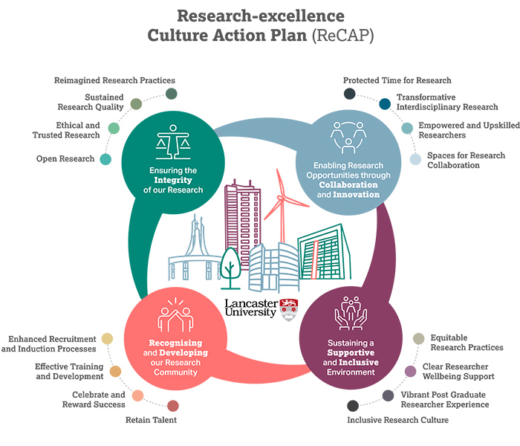
Lancaster receives funding from the Research England QR Enhancing Research Culture Fund
A proportion of this funding is allocated to this Scheme

Slide 3

Purpose of the Scheme
To help ‘bridge’ a gap between one research contract ending and the next one starting at Lancaster.
Benefits to the researcher- provides a degree of financial stability and researcher training and career development opportunities
Benefits to the institution- retention of talent, contribution to enhancing research culture activities

Slide 4
Eligibility Criteria
You must:
have been employed at Lancaster University for at least 18 months when your current contract comes to an end;
be employed at Lancaster up to the application submission;
have an indefinite with end date (indefinite contingent) or fixed term contract, which will be coming to an end on the 31 July 2027 or earlier;
be based in the UK for the duration of the scheme;
have as a minimum an application for an externally funded research project (or equivalent external income source) submitted or in progress on which you will be the/a researcher.

Slide 5
Terms of the Scheme
The funding will be offered on the same spinal point as on application.
The funding will typically be offered for a period of up to 3 months.
The funding is available until 31 July 2027.
The scheme will offer the equivalent full time equivalent (FTE) as on application, which could be across one or more contracts.
You must declare other employment, so that the scheme and any other employment does not exceed the equivalent of 1.0 FTE.
You are expected to make a positive contribution to research culture at Lancaster during the funded period.
You must have an identified mentor for the period of the scheme, ideally someone other than your PI/project lead.

Slide 6

Prioritisation
We anticipate more applications than we can support
If a research grant award has been made, and the start date known it may be approved outside a panel.
Most will be reviewed by a panel of senior staff from each faculty, chaired by the Director for Research Culture
Priority will be given to applications that:
provide strong evidence of future employment at Lancaster – through research grant/s and/or other external income sources
have clear plans of activities including training, skills and career development
articulate contributions to enhancing research culture at the Lancaster campus

Slide 7
What details are needed about research grants?
You will be asked to provide for each research funding application on which you would expect to be the/a researcher:
Name and ACP number of the grant application
Duration of the research grant
Funder and specific funding scheme/call
Status – in progress/submitted/successful, including details of stage when applicable
Date when outcome expected, including stages if applicable
Contribution you are making to the grant application
Your role within the application e.g. PI, Co-I, named researcher
Track record of working with the funder/s (PI to also include details in their support letter)
Any information, where known, about the chances of success given the funding scheme

Slide 8

When to apply
Applications can be received at any time, as some can be reviewed without going to panel.
You are encouraged to get your application in by 31 July 26, so it can be reviewed by the first panel, scheduled for the 13 August.
Further panel dates will be announced.
And following your application:
Keep in touch with us if your circumstances change, as this can affect your ranking
If successful, we hope that you are willing to provide a case study, to support others

Slide 9

Any Questions?
Email: researchculture@lancaster.ac.uk

