Slide 1
Millikan's Oil Drop Experiment

Slide 2
Motivation
After the discovery of the electron and calculation of the e/m ratio by J.J. Thomson in 1897, Millikan sought a way to measure the charge of an electron. If the charge could be found, the electron mass could also be calculated using e/m. He assumed (correctly) at the time that all electrons carried the same charge.
Millikan conducted an experiment that allowed him to determine the charge of an oil drop. According to his assumption all charges on oil drops must be a multiple of the electron charge.
Today you will conduct the same experiment and ultimately try to determine the value of e.

Slide 3
A Look at the Apparatus
In the box you will find:
A device containing two plates that are to be connected to a power source so a voltage can be applied between them, producing a uniform electric field
A nozzle containing oil, so that small, charged oil drops can be sprayed between the plates
A camera connected to a screen that displays a live feed of the area between the plates
A light to be shone between the plates so you can see what’s going on

Slide 4
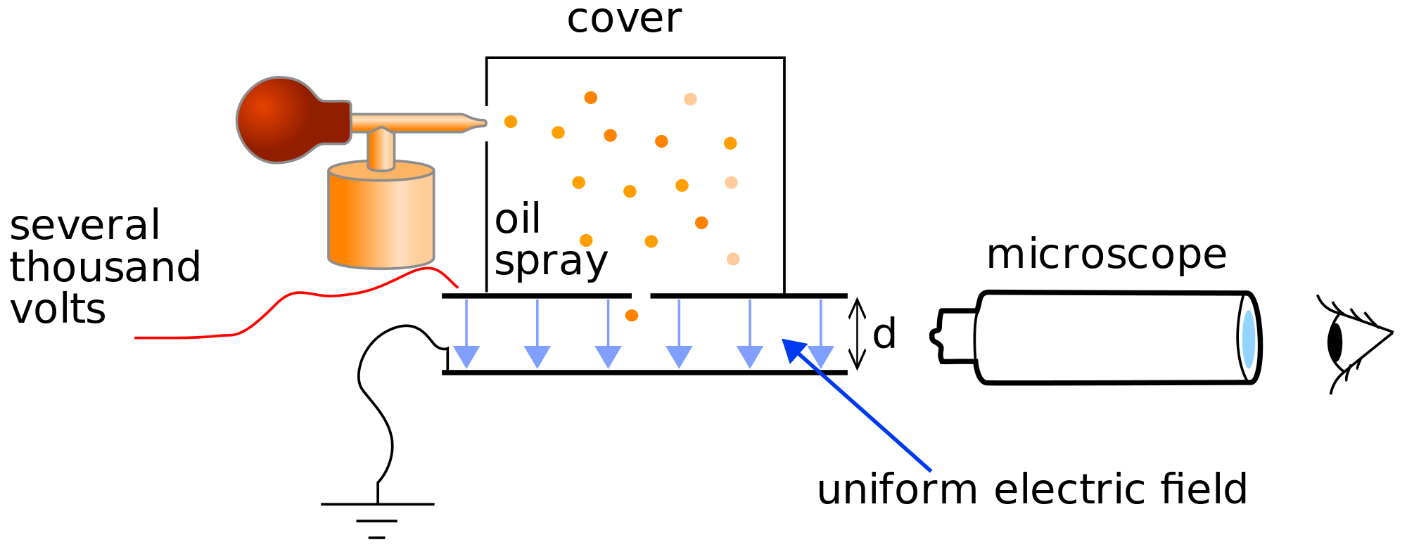

Slide 5
Question!
How do the oil drops become charged?

Slide 6
Answer:
Frictional effects between the sides of the nozzle an the oil
(In other variants of the experiment the oil drops are ionised using X-rays)

Slide 7
Procedure
Oil drops are sprayed in between the plates. You will notice with no applied voltage (therefore no electric field) the oil drops fall due to gravity.
Once a voltage is applied between the plates, you will notice some drops will slow down but keep moving down, a few will stop moving and others will start moving upwards.

Slide 8
Questions!
1. Why do some droplets move up and others down?
2. Why have some of the droplets stopped moving?

Slide 9
Answers
Oil drops that are moving up either contain many electrons or have a low mass (or both), as the force they experience due to the electric field is greater than their weight.
Drops that are moving down either contain a small amount of electrons or have a large mass (or both), as their weight is larger than the electric force.
2. The stationary drops are in equilibrium – the electric force is equal to the weight.

Slide 10
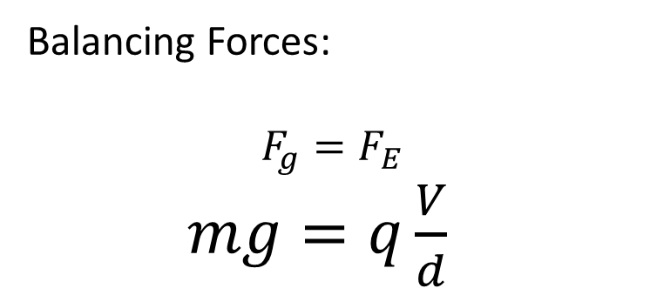
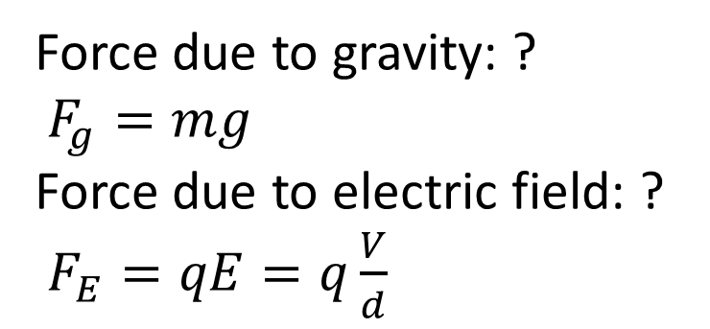
A Stationary electron
Where do the forces belong on the diagram?
+V
Balancing Forces:
$$F_{g}=F_{E}$$
$mg=q\frac{V}{d}$
0 V
Force due to gravity: ?
$F_{g}=mg$
Force due to electric field: ?
$F_{E}=qE=q\frac{V}{d}$
Question: Which of the above quantities would be hard to measure?

Slide 11
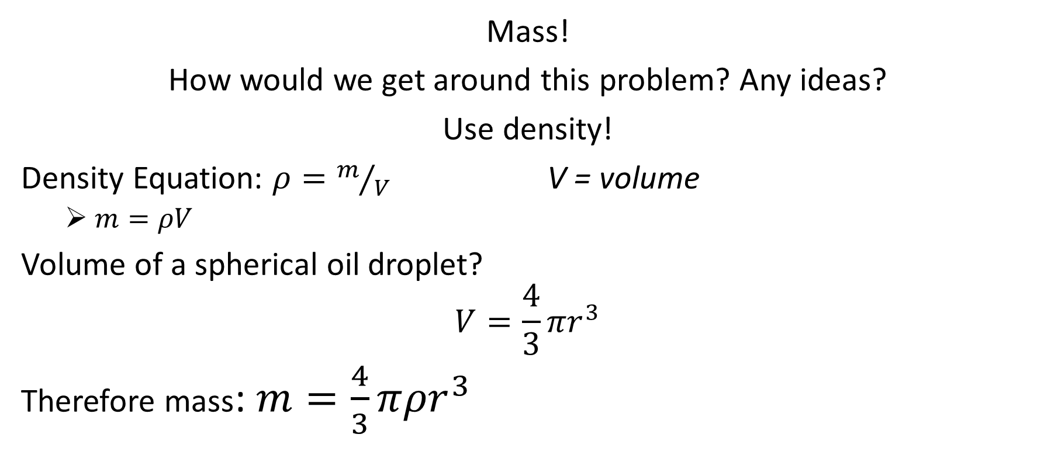
Answer:
Mass!
How would we get around this problem? Any ideas?
Use density!
Density Equation: $ρ=m/V$ V = volume
$m=ρV$
Volume of a spherical oil droplet?
$$V=\frac{4}{3}πr^{3}$$
Therefore mass: $m=\frac{4}{3}π{ρr}^{3}$

Slide 12

Back to our equation
Lets go back to our original equation and insert our new value for m:
$$m=$$
$$q\frac{V}{d}$$
$$m=$$
$$\frac{4}{3}π{ρr}^{3}$$
=

Slide 13
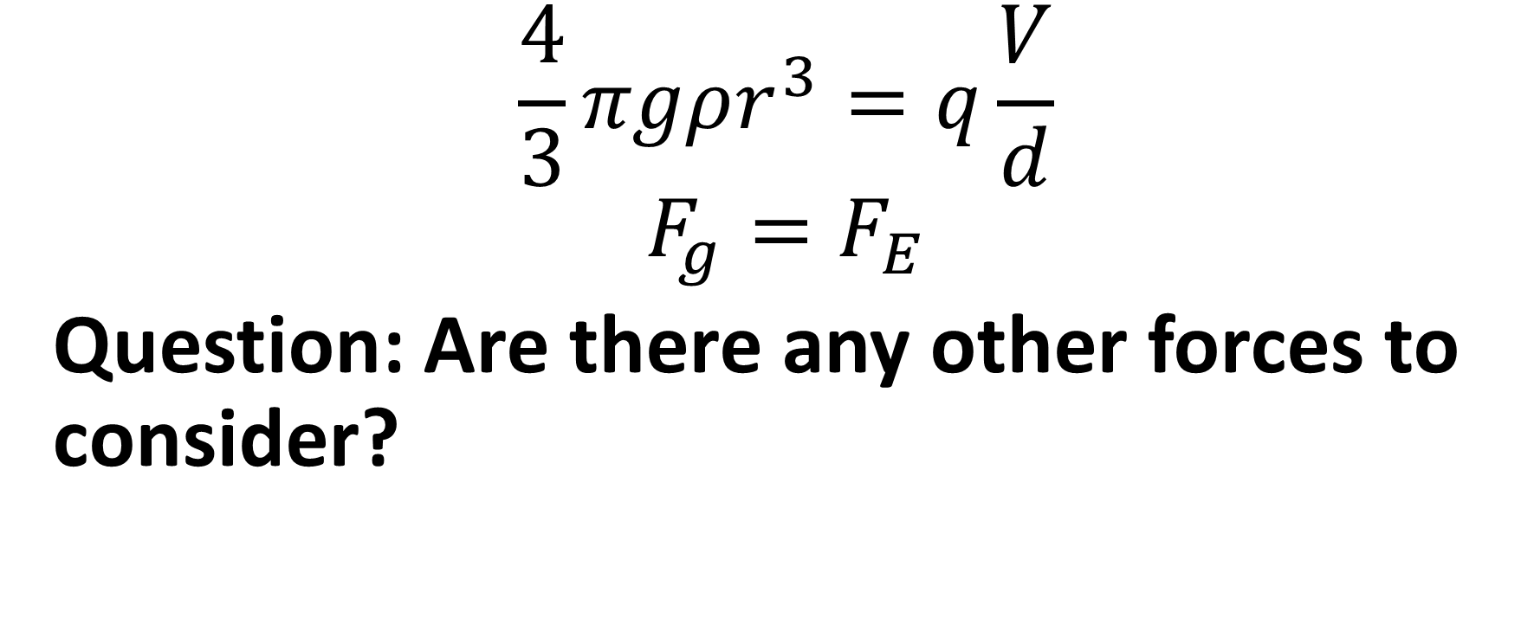
We now have:
$$\frac{4}{3}πgρr^{3}=q\frac{V}{d}$$
$$F_{g}=F_{E}$$
Question: Are there any other forces to consider?

Slide 14
Answer
Yes! Remember the drop is in air, not a vacuum, so there is an upwards buoyancy force equal to the weight of air displaced (Archimedes' principle)
Question: What is the expression for the buoyancy force?
Hint – Consider the expression for the weight of the oil drop

Slide 15
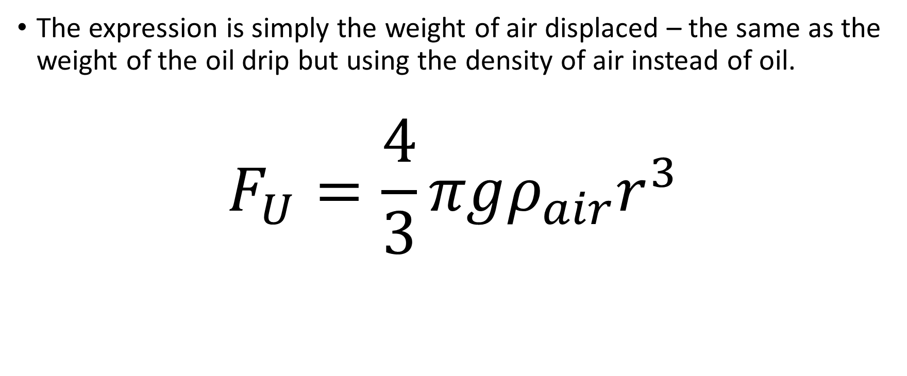
Answer
The expression is simply the weight of air displaced – the same as the weight of the oil drip but using the density of air instead of oil.
$$F_{U}=\frac{4}{3}πgρ_{air}r^{3}$$

Slide 16
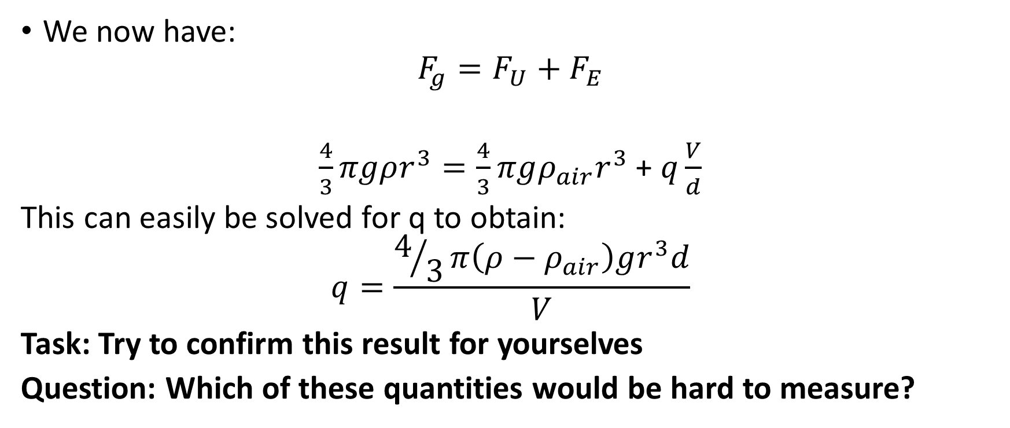
Back to our equation
We now have:
$$F_{g}=F_{U}+F_{E}$$
$\frac{4}{3}πgρr^{3}=\frac{4}{3}πgρ_{air}r^{3}$ + $q\frac{V}{d}$
This can easily be solved for q to obtain:
$$q=\frac{4/3π\left(ρ−ρ_{air}\right)gr^{3}d}{V}$$
Task: Try to confirm this result for yourselves
Question: Which of these quantities would be hard to measure?

Slide 17
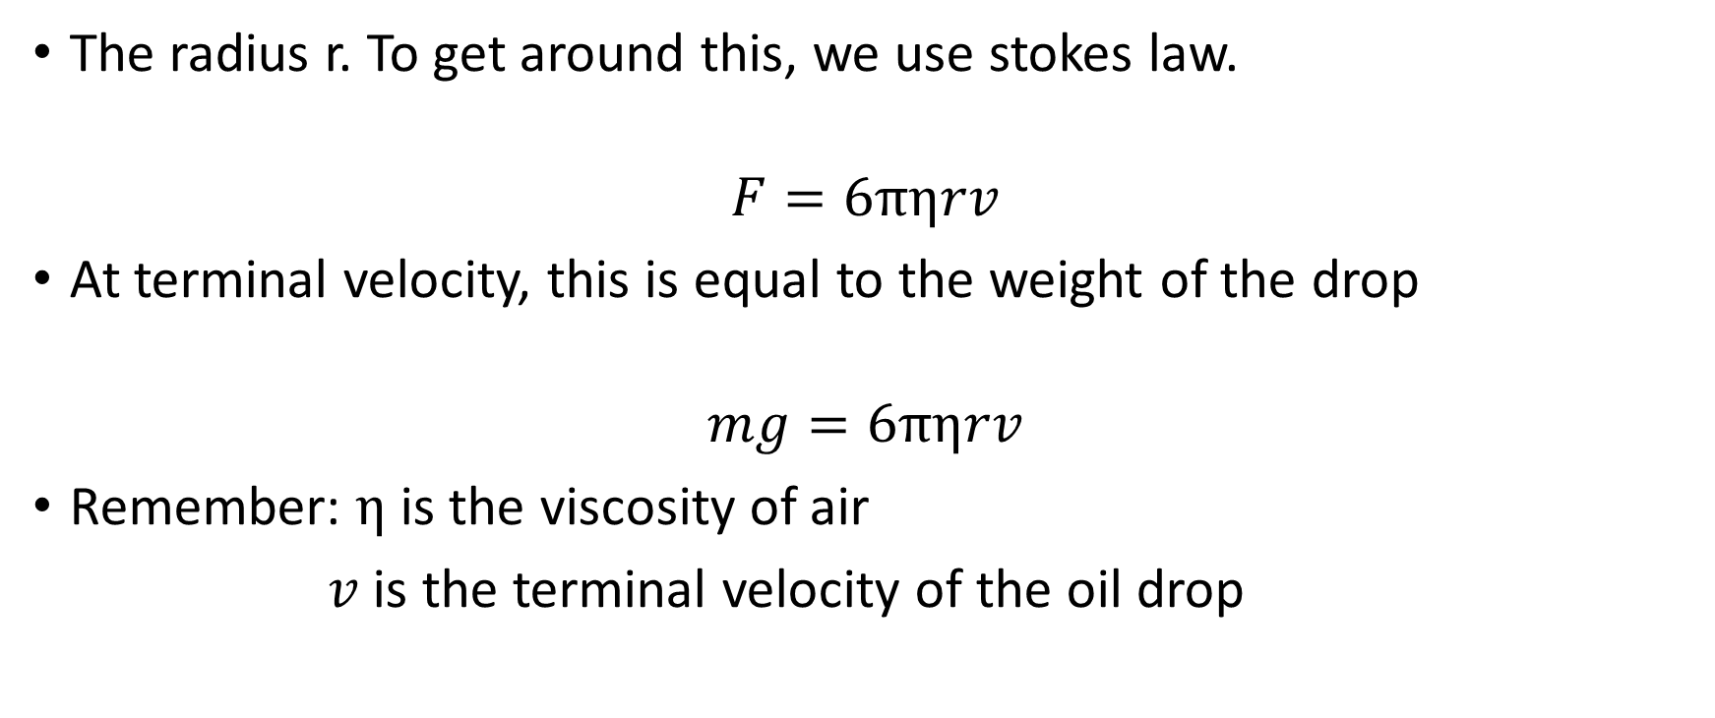
Answer
The radius r. To get around this, we use stokes law.
$$F=6πηrv$$
At terminal velocity, this is equal to the weight of the drop
$$mg=6πηrv$$
Remember: $η$ is the viscosity of air
$v$ is the terminal velocity of the oil drop

Slide 18
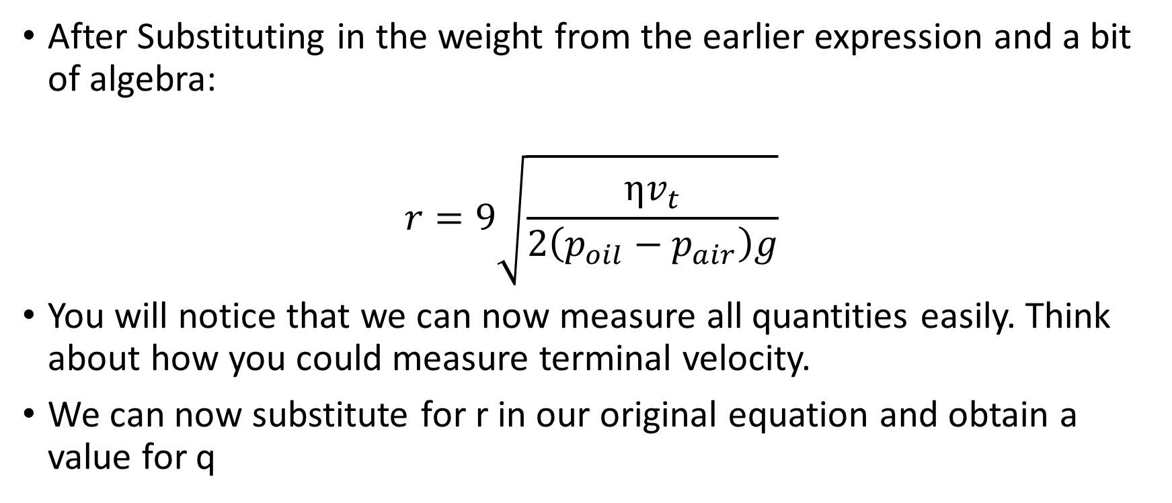
After Substituting in the weight from the earlier expression and a bit of algebra:
$$r=9\sqrt{\frac{ηv_{t}}{2\left(p_{oil}−p_{air}\right)g}}$$
You will notice that we can now measure all quantities easily. Think about how you could measure terminal velocity.
We can now substitute for r in our original equation and obtain a value for q

Slide 19
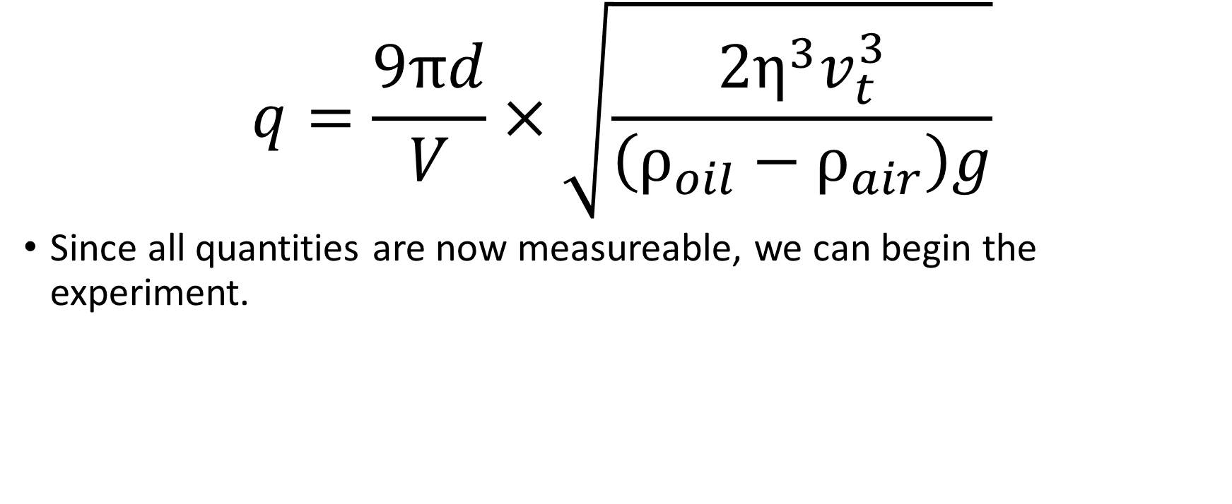
$$q=\frac{9πd}{V}×\sqrt{\frac{2η^{3}v_{t}^{3}}{\left(ρ_{oil}−ρ_{air}\right)g}}$$
Since all quantities are now measureable, we can begin the experiment.

Slide 20
Procedure
Open the provided EXCEL table
Illuminate the oil chamber with the lamp and angle the camera towards the screen so you get a good, clear image and can read the scale
Give the bulb one or two squirts and observe the oil droplets on the screen
Turn on the voltage supply and vary the voltage. You should see the drops move up and down.
Pick an easy-to-see oil drop and find the voltage required to hold it steady and record this voltage

Slide 21
Turn the power supply off and measure the time taken for the drop to travel a given distance (the larger the better)
Record these values and add them to the table
EXCEL should now calculate all required quantities and return the charge of the selected oil drop
Repeat this process five more times if you can
Question: Which measuremeant gives the largest uncertainty?

Slide 22
Answer
The distance the drop falls as it is the hardest to see

Slide 23
Values of constants
air viscosity, η = 1.83 ± 0.04 × 10⁻⁵ Nsm⁻²
oil density, ρ = 874 ± 2 kgm⁻³ at 20◦C
air density, ρ = 1.30 ± 0.05 kgm⁻³ at 20◦C
plate spacing, d = 6.00 ± 0.05 × 10⁻³ m
friction coefficient, A = 7.7776 ± 0.0001 × 10⁻⁸ m

Slide 24
Finding a value for e
Divide each of your charge values by the accepted value for e, 1.6 X 10 ⁻¹⁹ , and round to the closet integer
This is the number of electrons your oil drop contains
Finally, find the total charge on all oil drops and divide this by the total number of electrons on all oil drops

Slide 25
Conclusions
Does your value agree within uncertainty with the expected value of e= 1.6 X 10 ⁻¹⁹ c ?
What is the largest source of uncertainty?
Could you improve the experiment in any way?

