Slide 1


Using Pure for REF2029
Research Output Review

Slide 2

Review Lifecycle

Slide 3
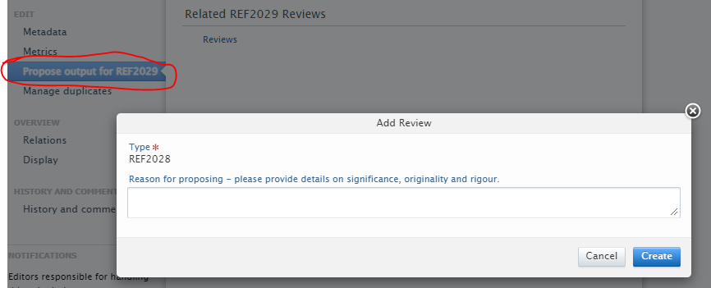
Proposing an Output
Who can propose outputs?
Academics can propose their own
Editors/admins can propose for other users
How to Propose?
Open the output record
Click “Propose output for REF 2029.
Enter the reason.
This is visible to all authors but not the reviewers.

Slide 4
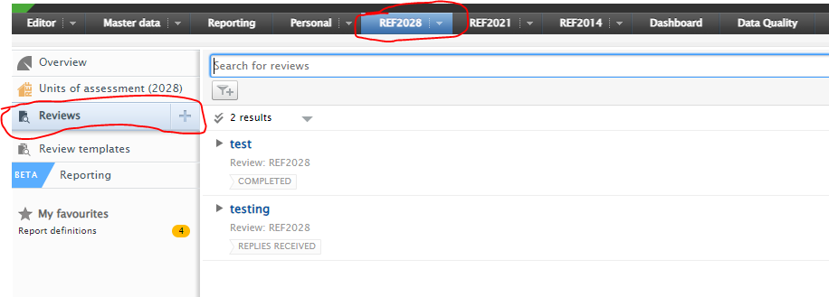
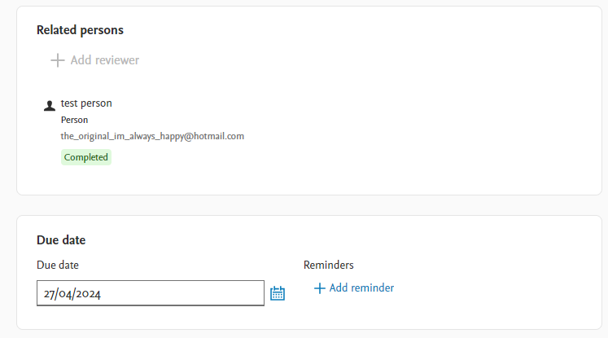
Assign Reviewers
Who can do it?
Only specific users with “Editor of Review” role
How to assign reviewers
Open Reviews
Open the correct review
Find “+ Add Reviewer”
You can add multiple reviewers
Add Due date

Slide 5
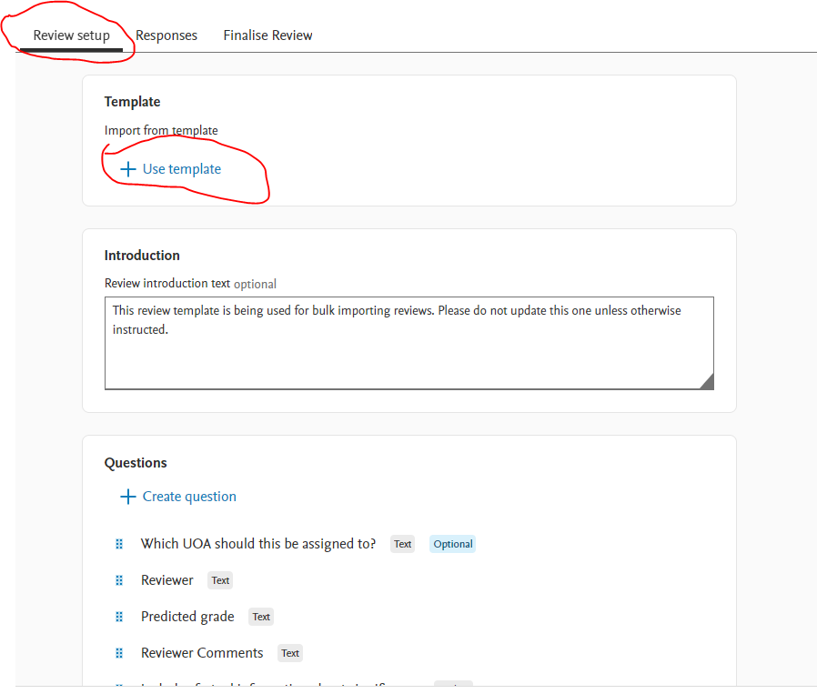
Assign the template
We currently use one template for reviews
Click “Review setup”
Click “+Use Template” and select REF2029.

Slide 6
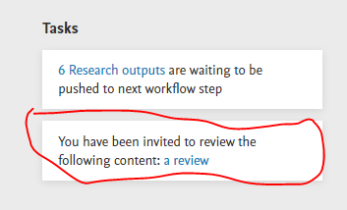
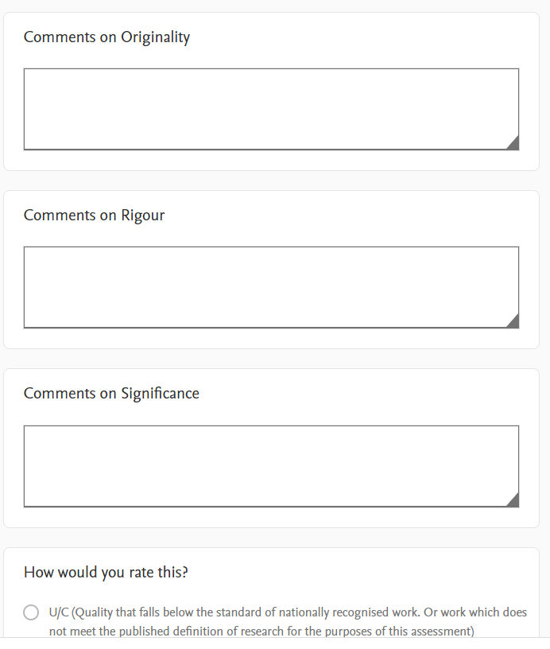
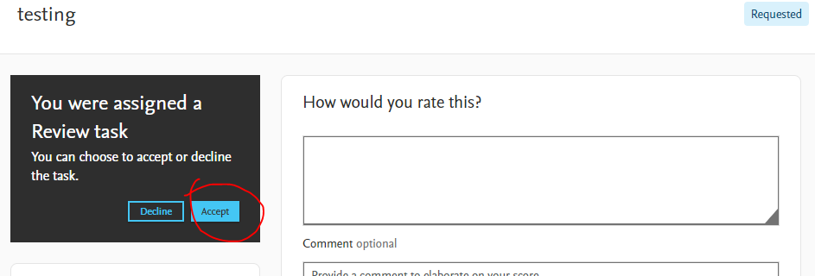
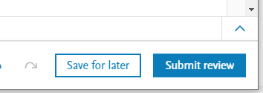
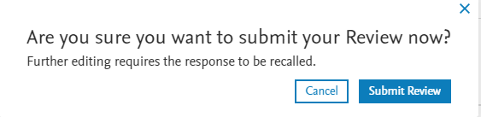
How to Review
Once invited you will receive and email and a task about the review:
Click on the title
Accept the review
Complete the questions
Click submit review
Confirm submission

Slide 7
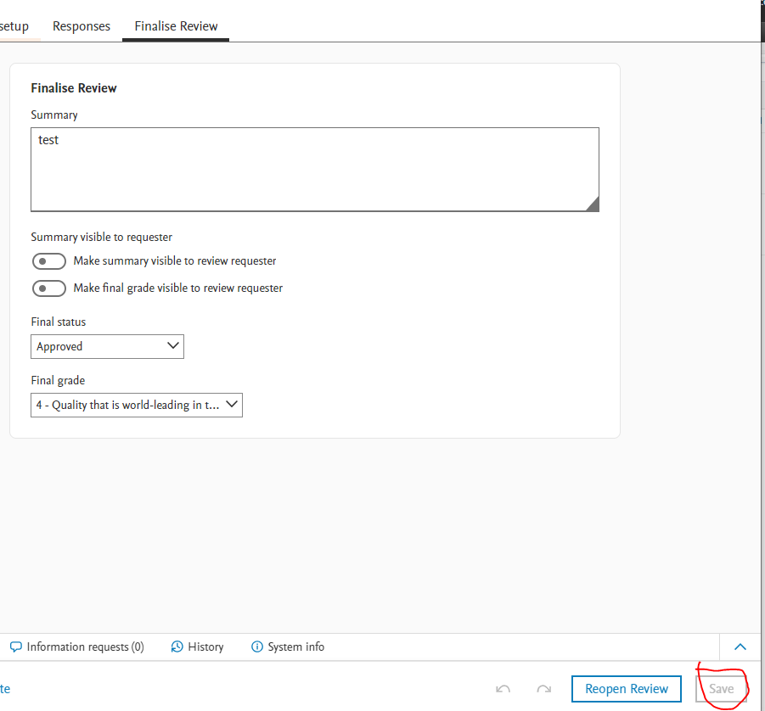
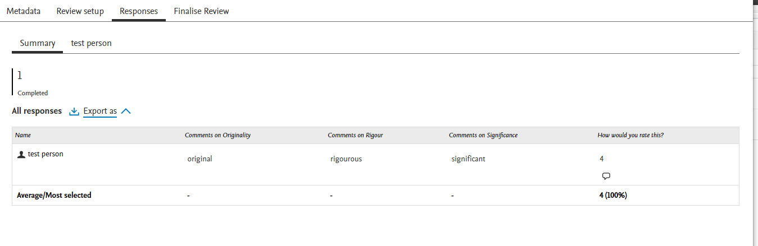
Finalise the Review
Allows Review admins to see the summary of the reviews for the output.
Fill in the final summary
Click “Save”.

Slide 8
Importing Reviews
Pre-existing reviews
External reviews
Fill in template

