Slide 2
Career explorations: where to start and when to stop
Dr Stefania Silvestri
Researcher Developer

Slide 3
Session outcomes
Start your career exploration
Identify and access key resources to help you get started
Recognise when you've done enough research into a role/sector.
Apply practical tools and techniques to shift your decision and move forward effectively

Slide 4
How to explore career opportunities
Treat your career exploration as a research project

Slide 5
Applying your research skills to your career exploration
Searching for information
Taking notes
Problem solving
Attention to detail
Time management
Communicating results

Slide 6
Exploration strategy 1
Mapping your warm network

Slide 7
What is your warm network?
The people who you know and that know you in some kind of personal or professional capacity.
Family and friends
Colleagues and ex-colleagues
Acquaintances

Slide 8
Why start with your warm network?
Quick and simple way to start your exploration and get some ideas. Easy to have informal chats and they can provide support.
Gets you started and provides motivation
Can share your career aspirations and they can help you find other people to connect with
Shared background gives you confidence that you can move forwards too

Slide 9
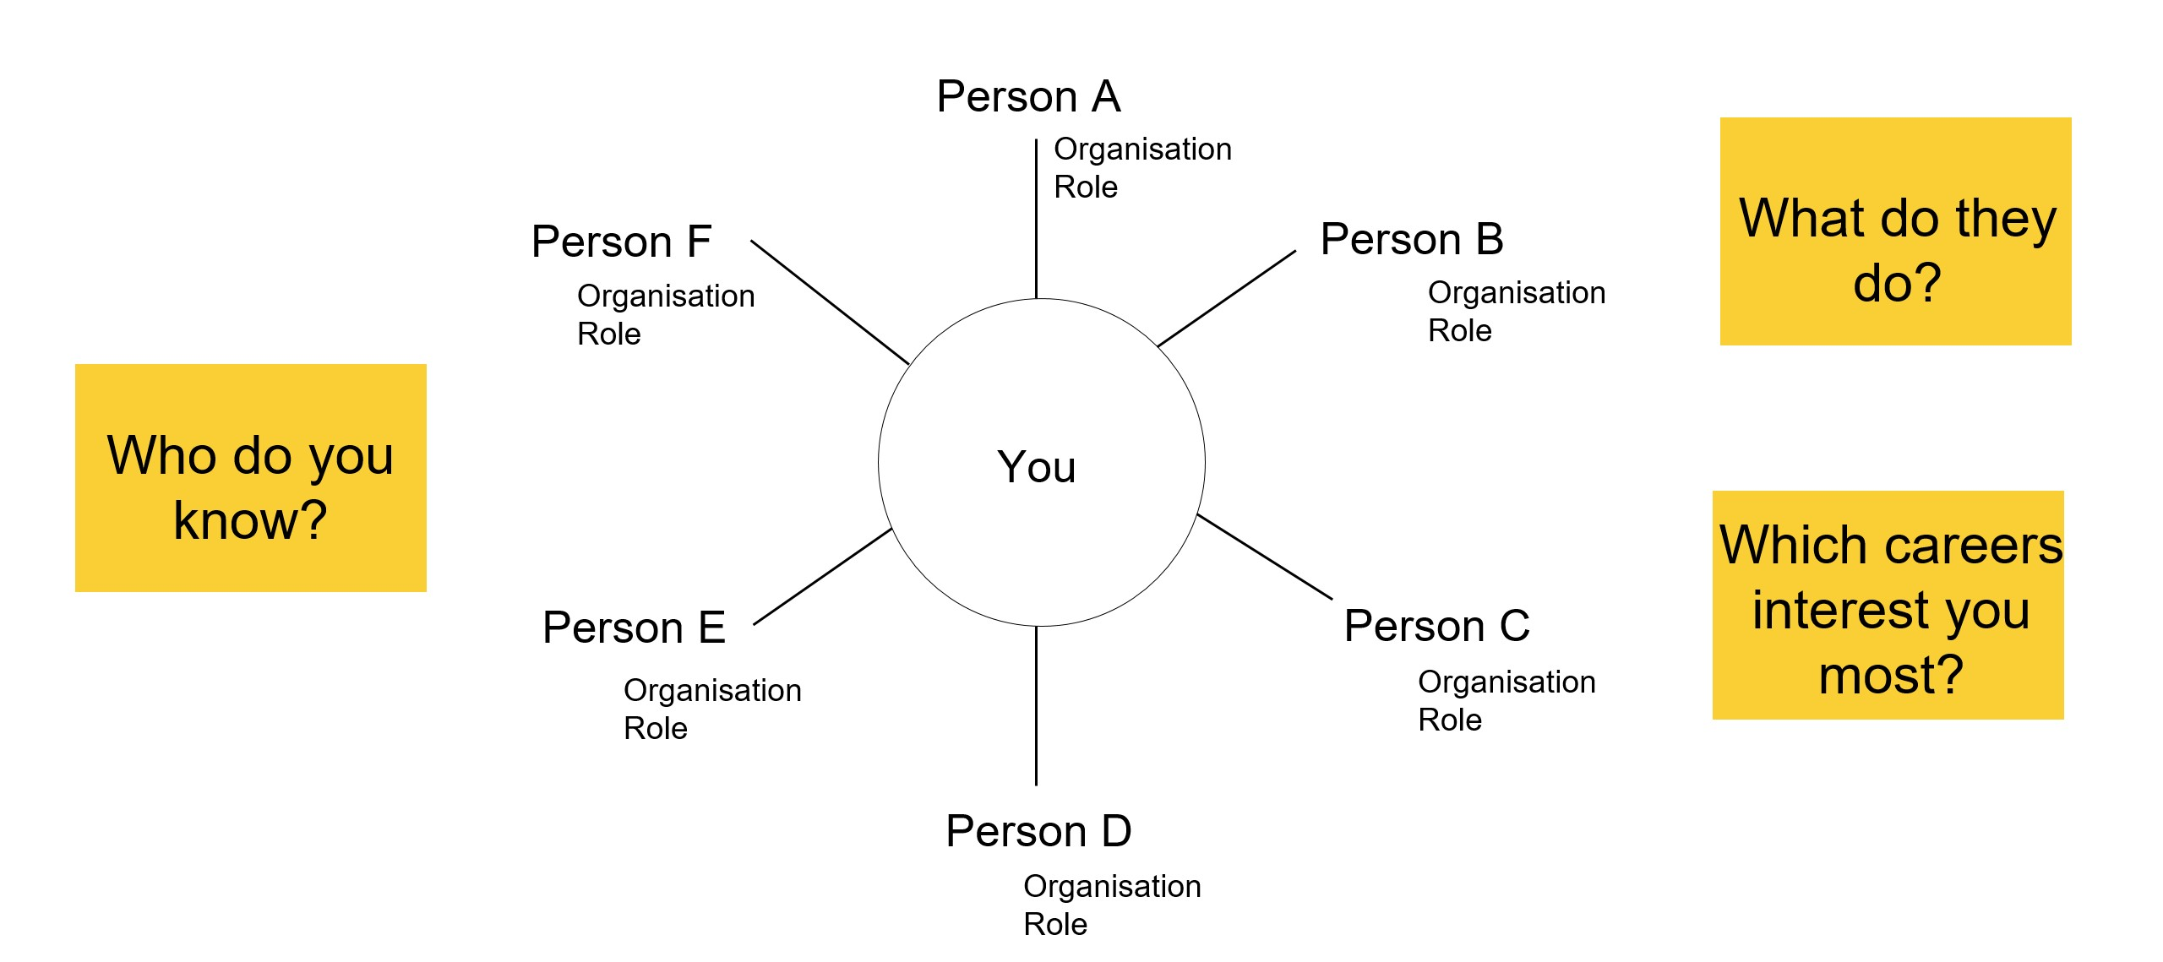
Activity 1 – Plotting your warm network

Slide 10
Exploration strategy 2
Expanding your knowledge of organisations

Slide 11
Tools to gather information
Career Clusters on the Prosper Portal
Google
Organisation’s website
Business Databases
Other relevant websites
Glassdoor
LinkedIn

Slide 12
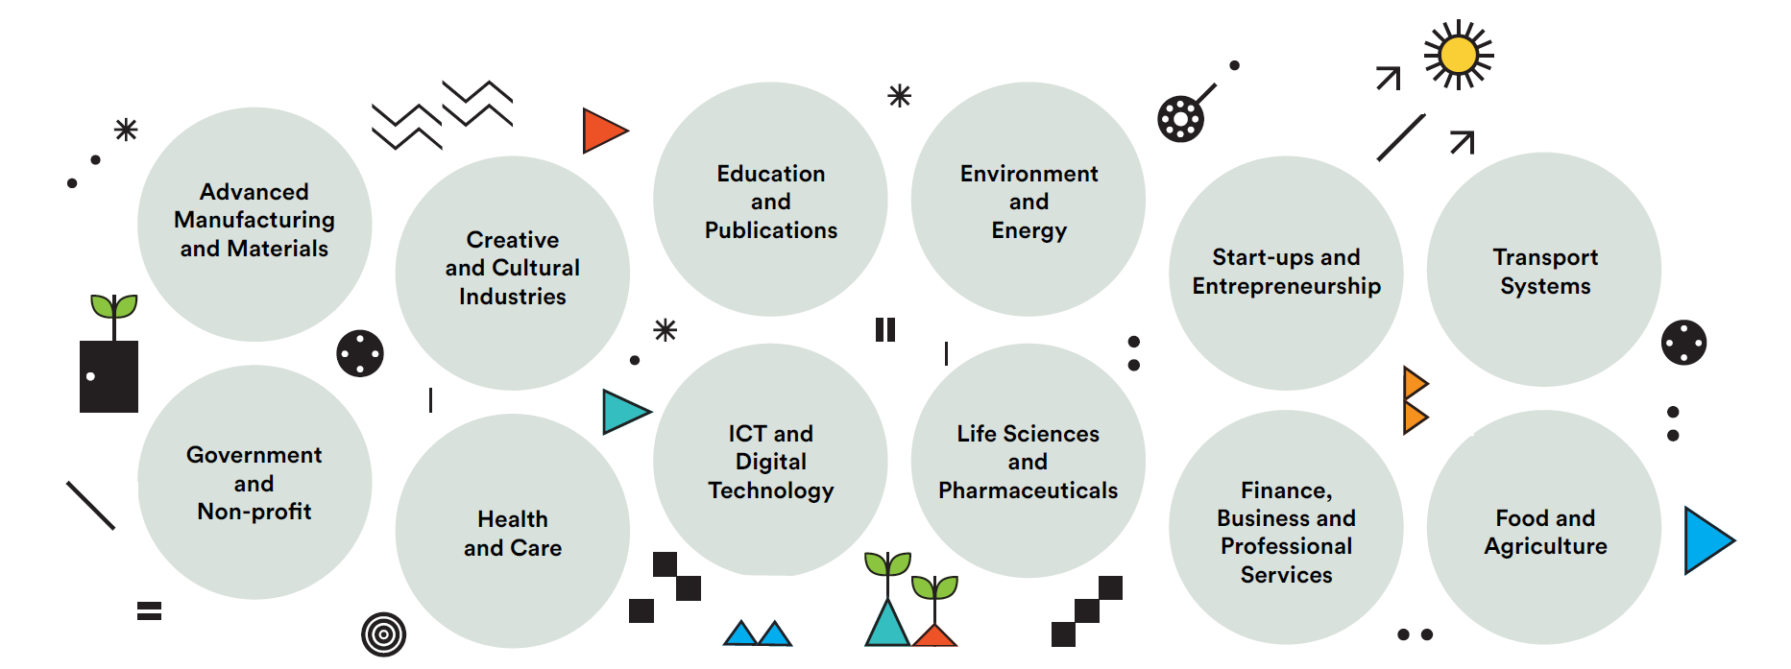
Career Clusters
Higher Education and Publishing
Financial, Business and Professional services

Slide 13
What each tool points to
Google:
Company's website
Contacts and social media
What ‘People also searched for’ to identify competitors
Company's website:
Who they are (culture)
What they do (ethics)
Why they do it (values)
Business database (Marketline, Nexis, D&B Hoovers):
Financial details
Company's details
Sector and competitors
Charity commission:
Annual income
Trustees' details
Glassdoor:
Reviews from employees
Salaries
LinkedIn:
Company's page
Followers
Posts and insights into their activities

Slide 14
Exploration strategy 3
Using LinkedIn (or other job boards) and AI to explore different roles

Slide 15
Do you have a LinkedIn account?
How regularly do you use it?
How often do you make new connections?
https://prosper.liverpool.ac.uk/learning-development-clusters/networking/?playlist-load=networking-online-including-linkedin

Slide 16
Using job boards
Indeed, Glassdoor and LinkedIn – can use them together
Job titles: don’t obsess about them, they may even limit you!
Employers hire YOU, they might not always know what they want and your job title could change or be negotiated
Notes:
Three of the major job boards used in the UK are Indeed, Glassdoor and LinkedIn and you can use them in combination. Just a word about job titles before we begin. We’re often asked for lists of job titles as a means to start exploring, but do not obsess about them, they are constantly changing, mean different things in different organizations and they may even limit you by narrowing your search. Employers hire YOU and the skills YOU can bring, they might not always know exactly what they want and your job title could change or be negotiated when you start.

Slide 17
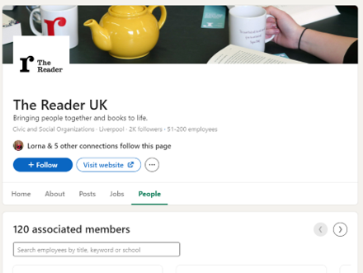
LinkedIn job search
Search for the organisation of interest to you and identify people within that organisation
Notes:
Using the People tab on the organizations LinkedIn page, you can see who works there and what their job title is (make a note of these) and also whether you know anyone there or one of your connections does. You can ask to connect with them (more on the next slide).

Slide 18
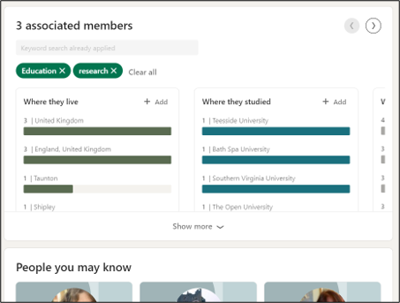
LinkedIn job search
Look for people with a PhD in the organisation
Look out for talent acquisition managers in larger organisations
Notes:
So how do you reach out to people on LinkedIn? If you take the example of The Reader, under the people tab you can see who works there and request to connect. You can search for the organization of the job that interested you, identify people within that organization, perhaps you could look for those with PhDs (you have something in common that could trigger them to reply to your message). Also, at larger organizations, look out for talent acquisition managers whose job it is to interact with potential recruits.
If you don’t have any link to them, its best to write a short message (e.g. Hi, I’m really interested in your organisation and I was hoping to connect with you. If you can spare some time, I would love to ask you a few questions) with your connection request. Alternatively, you could just try to connect and see if they accept. If you have LinkedIn Premium, you can send InMails to people you are not connected with, which have a greater chance of reply. People might not reply, but don’t take this personally, it’s just part of the process.

Slide 19
Using AI to explore job roles
Provide effective prompts!
some background and purpose of request
key responsibilities,
desirable skills,
necessary qualifications,
typical career progression,
use follow up questions on specific areas
MS copilot example:
I am a researcher in Humanities in the UK considering a new career in the GLAM sector as a Librarian, in France. Provide a typical, in-depth description of this position, including key responsibilities, desirable skills, necessary qualifications, and typical career progression. Include insights into the specific tasks this role might involve.

Slide 20
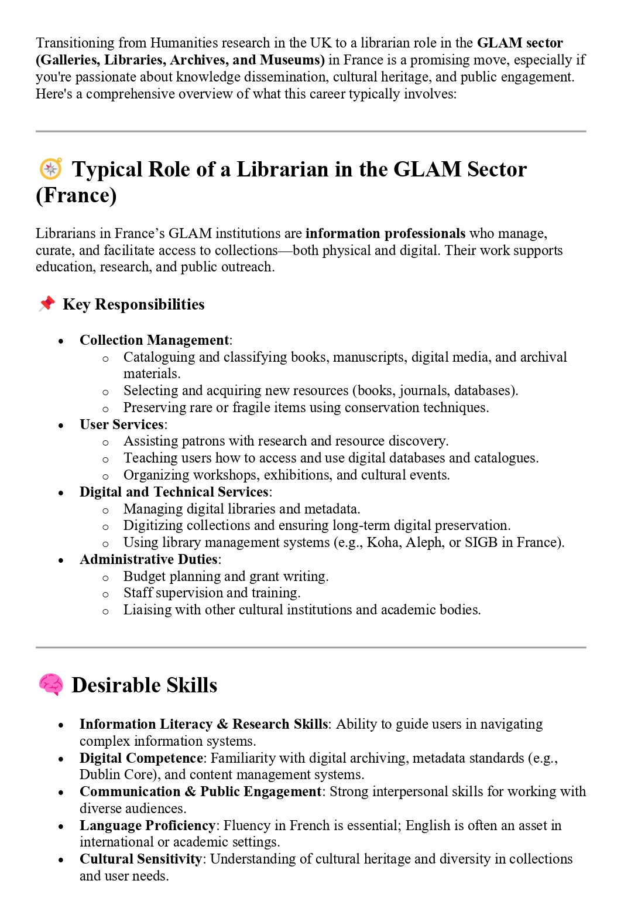
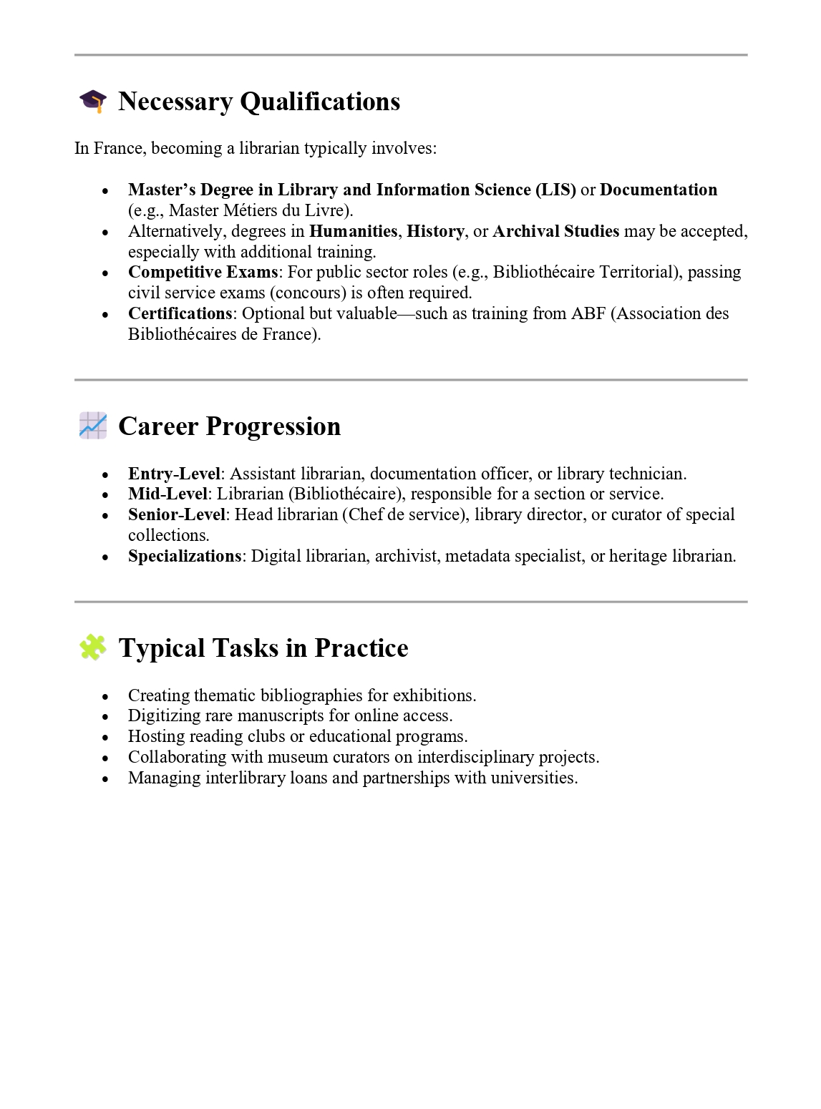

Slide 21
What next?

Slide 22
How to take the exploration to the next step
Make connections
Ask for informational interviews

Slide 23
Prepare for an informational interview with an elevator pitch
A concise professional introduction of yourself (or your product)
30-60 seconds long
Useful to have ready in advance of networking opportunities
Purpose is to initiate conversation
"A succinct pitch (Speech or other behaviour designed to persuade, influence, or cajole, esp. in order to sell goods or promote an idea) intended to impress or persuade a potential customer, investor, employer, etc."
Oxford English Dictionary

Slide 24
Activity 2 – Elevator pitch
2 min: write your pitch
7 min: in pairs – present your pitch, gather feedback, improve your pitch
Swap pairs – go again!

Slide 25
Have you gone down the 'rabbit hole'?

Slide 26
Data saturation – qualitative research
Saturation means that no additional data are being found […]. As he [the sociologist] sees similar instances over and over again, the researcher becomes empirically confident that a category is saturated."
Glaser and Strauss,
The Discovery of Grounded Theory, 1967

Slide 27
How to stop your explorations
Understand influences on decision making
Set a stop rule

Slide 28
Influences on decision making
Internal factors (values, family)
External factors (job market, visa issues)
Emotional distance
Assumptions (more/less flexibility, pure research)
Emotions (overwhelm, imposter feelings, what will others think)
Perspective

Slide 29
Decision making tools
Decision making model and goal setting frameworks
Trigger point / stop rule

Slide 30
Decision making tools
Decision making model and goal setting frameworks
TDODAR decision model (time, diagnoses, options, decide, assign, review)
OODA loop (observe, orient, decide, act)
GROW model (goal, reality, options, way forward)
SMART goals (specific, measurable, achievable, relevant, and time-bound)
Double Diamond (design process)
NLP well-formed outcomes

Slide 31
Decision making tools
Decision making model and goal setting frameworks
Trigger point / stop rule
“It’s a rule that says at this point it’s time for me to stop. […] it gets you outside of the space you’ve been in. The best thing to do is to use a declarative statement like, “I don’t watch more than two episodes of a show in a row, that’s just not who I am.”
https://www.theladders.com/career-advice/the-stop-rule-when-you-should-rethink-a-decision

Slide 32
Variation of a stop rule
Non-negotiable limit (if we don't reach the summit by 2 pm, we turn around)
Flexible limit (if my heart rate is still below 150 by 2 pm, I will keep climbing until 3 pm)

Slide 33
Activity 3 – set yourself a stop rule
Examples
I will only look into this organisation for the next 30 minutes.
If I have not found 3 job profiles in this sector that align to my values in the next 3 days, I will continue for a maximum of 7 days.
I will make new connections on LinkedIn for the next month, and will ask for informational interviews until I have scheduled 2.

Slide 34
Actions

Slide 35
Before leaving
Make a plan on your personal career exploration, using one of the decision-making framework
Explore more the career clusters and use LinkedIn or another job board to find people that work at the company you are interested in https://prosper.liverpool.ac.uk/postdoc-resources/explore/career-clusters/
Set yourself a stop rule and stick to it!
Explore the resources on the portal that will help in taking your exploration forward: https://prosper.liverpool.ac.uk/curations/?share-token=QUST-54-DJYC-59-LRM7-JTMW

Slide 37
CV speedreading
Dr Stefania Silvestri
Researcher Developer

Slide 38
Ground rules
Giving feedback
Receiving feedback

Slide 39
Task 1 – 30 seconds
Read the CV and then answer the following questions.
Describe the author of this CV in three words
What do you think are the author’s top skills and attributes?
What stood out to you about this CV?

Slide 40
Task 2 – 3 minutes
Read the same CV as for task 1 and then answer the following questions.
What sector or industry do you think this CV is aimed at?
How clear is this CV – what is the layout like?
What is good about this CV?
What could be even better about this CV?

Slide 41
Reflection and feedback
What worked well in the CVs you reviewed?
What issues did you come across?
What was particularly memorable and made the CV stand out?
How has it made you think about how your CV might be received by recruiters / hiring managers?

Slide 42
Actions

Slide 43
Reflect on the CVs you've seen today and work on your own CV
Commit to reviewing your CV
Prepare a master CV
Prepare two shorter CVs suitable for different audiences

