Slide 1

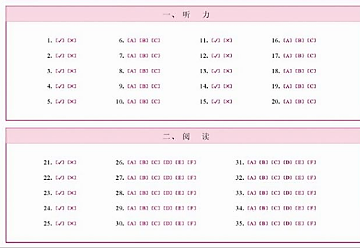

The Youth Chinese Test also known as YCT is a recognised international Chinese language test for primary and secondary school students.
You will only need to know 80 Vocabulary Words for YCT Level 1.
You will only need to know 150 vocabulary words for YCT 2 (80 of those are from YCT 1 so it's just an extra 70 words).
YCT 3- 300 vocabulary words (150 of those are from YCT 2 so it's just an extra 150 words).
YCT is all multiple choice.

Slide 2





Why do the YCT test.
A possible start to travel the world……..
Passing the YCT test proves that you have a basic understanding of the
Chinese language .You will be awarded a certificate as a record of
your achievement.
The YCT Certificate is internationally recognised, making it an important qualification
when applying for Chinese universities.
YCT 1 is also one of the easiest international tests of Mandarin that can be taken before
the age of 15.

Slide 3
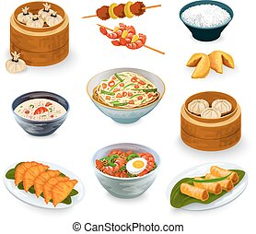


Looking ahead to the future, if you have the desire to travel and explore when you are between 17 and 35 years old, you can continue to progress and pass the HSK level 3. Achieving a high score opens opportunities for scholarship grants offered by the Confucius Institute, enabling you to study in China for either four months or four weeks.
During your time in China, you can immerse yourself in the local culture and savour the delicious cuisine.

